Slide 1
Games Bootcamp
Optimisation

Slide 2

Optimisation
Optimisation is the process of refining a game's performance to run smoothly and efficiently on targeted hardware.
CPU-Bound:
Physics
AI
Update()
GPU-Bound:
High-resolution textures
Shaders and post-processing
Particle Systems

Slide 3
01
CPU Optimisation

Slide 4
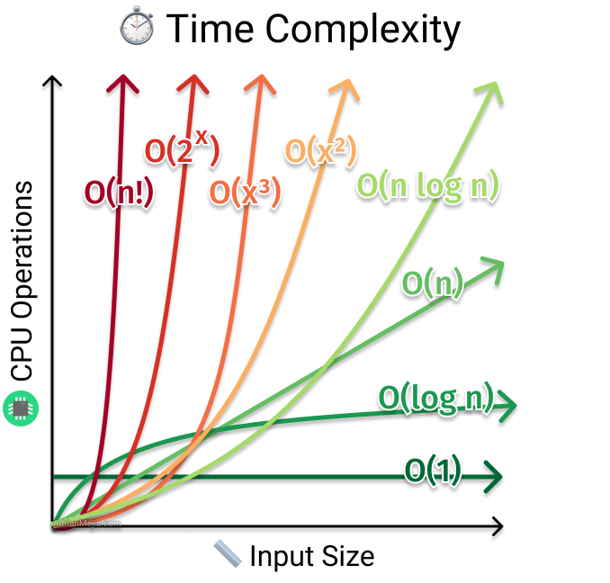
CPU Optimisation (1)
Big O Notation: Computer science concept denoting the efficiency of an algorithm by denoting it’s completion time.
Time Complexity: time an algorithm takes to complete based on the size of its input. It's a measure of speed or how long our code will run.
Space Complexity: memory space that an algorithm uses to produce its output. It's a measure of how much memory our code will use.
Often, there's a trade-off between the two. An algorithm that's fast might use more memory, while a slower algorithm might use less memory.
Notes:
There is a unity package but we will be making a basic solution to understand how the process would work.

Slide 5
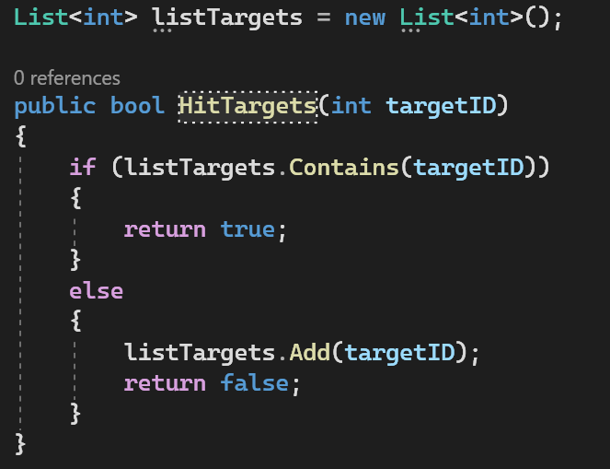
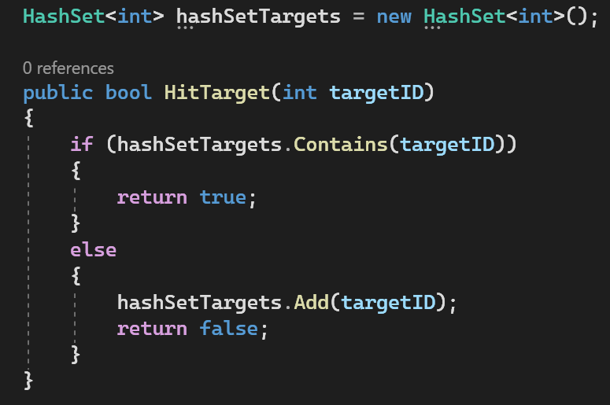
CPU Optimisation (2)
Notes:
There is a unity package but we will be making a basic solution to understand how the process would work.

Slide 6
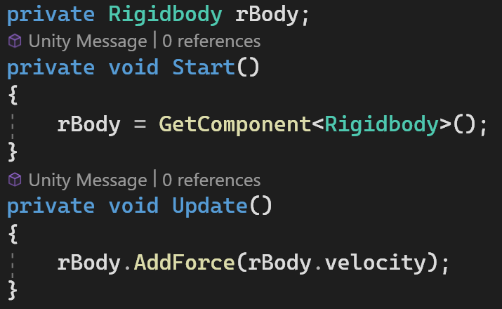
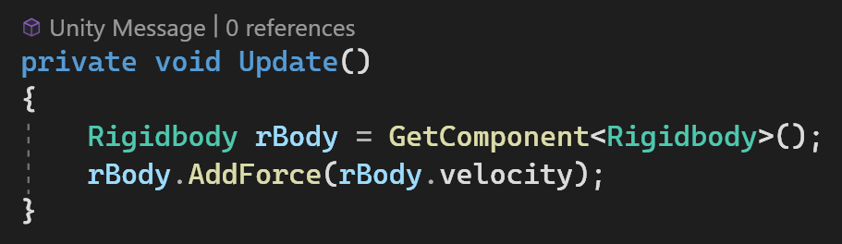
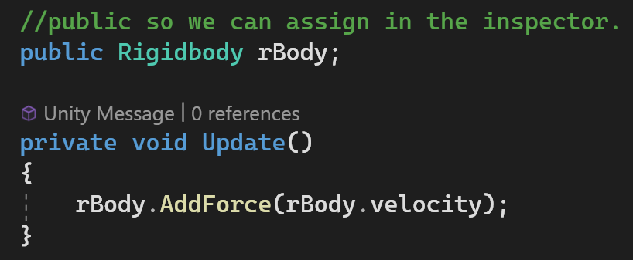
CPU Optimisation (3)
Caching: practice of storing frequently used data or references for quick retrieval.
Component Caching: it is generally better to assign a reference in the inspector but if needed GetComponent<T> should be called once.
X
Notes:
There is a unity package but we will be making a basic solution to understand how the process would work.

Slide 7
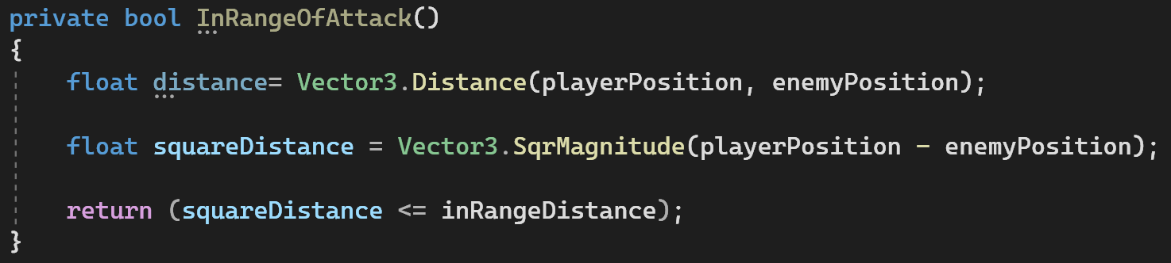
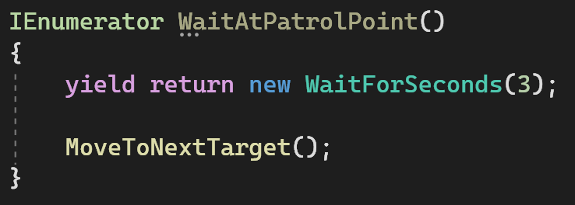
CPU Optimisation (4)
Avoid Square Root: use squared magnitude and adjust your calculations accordingly.
Reducing the number of Update Calls: use coroutines for delays, timers and infrequent checks.
Notes:
There is a unity package but we will be making a basic solution to understand how the process would work.

Slide 8
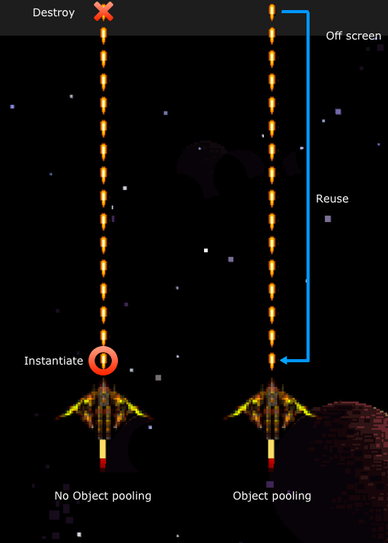
CPU Optimisation (5)
Object Pooling:
objects is "pre-instantiated" and recycled.
It's especially useful in scenarios where objects are frequently created and destroyed
For example bullets in a shooting game or enemies in a wave-based game.
we can save CPU time and reduce the potential of causing "garbage collection" spikes.
Notes:
There is a unity package but we will be making a basic solution to understand how the process would work.

Slide 9
02
GPU Optimisation

Slide 10
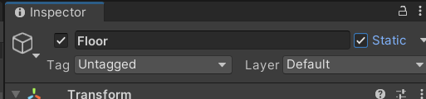
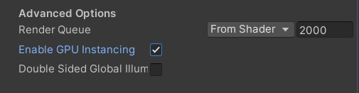
GPU Optimisation (1)
Batching: By grouping objects together the GPU can draw them more efficiently or in fewer ‘Draw Calls’
Static Batching: Combines static (non-moving) objects into a single mesh, allowing them to be drawn in a single draw call.
Dynamic Batching: Groups together small movable objects so they can be drawn in a single draw call, without combining them into a single mesh.
GPU Instancing: Utilizes the GPU's ability to draw multiple instances of the same mesh using different parameters.
Notes:
There is a unity package but we will be making a basic solution to understand how the process would work.

Slide 11
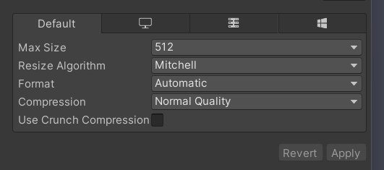
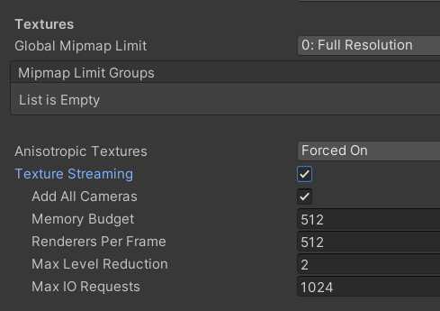
GPU Optimisation (2)
Texture Optimisation: Textures are image files wrapped around 3D models. Their size, format and resolution impact performance.
Unity Provides Platform-specific settings.
Mipmaps for Distance Rendering: Mipmaps are smaller versions of the texture that are used when the texture is far away from the camera.
Notes:
There is a unity package but we will be making a basic solution to understand how the process would work.

Slide 12
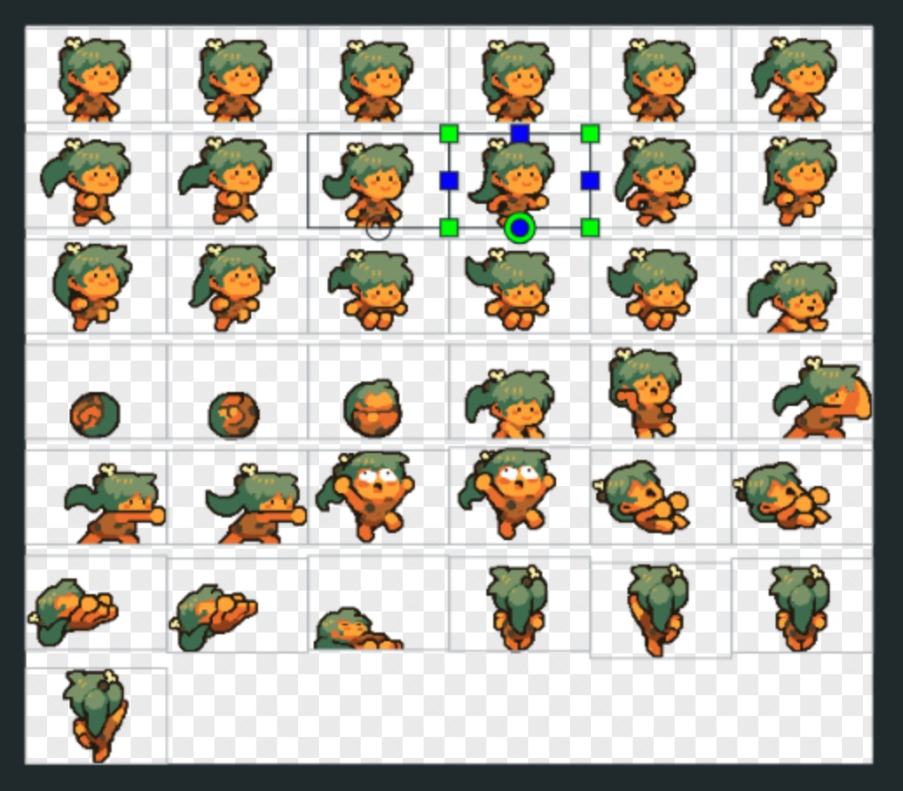
GPU Optimisation (3)
Texture Atlasing: combine multiple small textures into a single larger texture (atlas) to reduce draw calls.
Power of Two Sizes: Use textures sizes that are powers of two (e.g., 128x128, 256x256, 512x512) to ensure compatibility and efficiency, as GPUs handle these sizes more efficiently.
Max Size and Resolution: Set the max size of your textures appropriately; not every texture needs to be 4096x4096.
Notes:
There is a unity package but we will be making a basic solution to understand how the process would work.

Slide 13
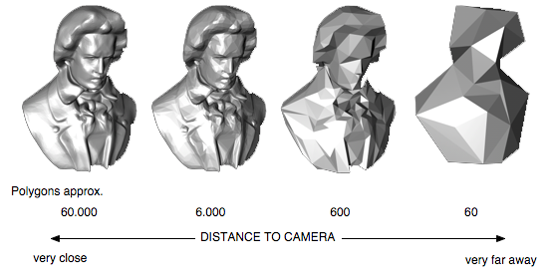
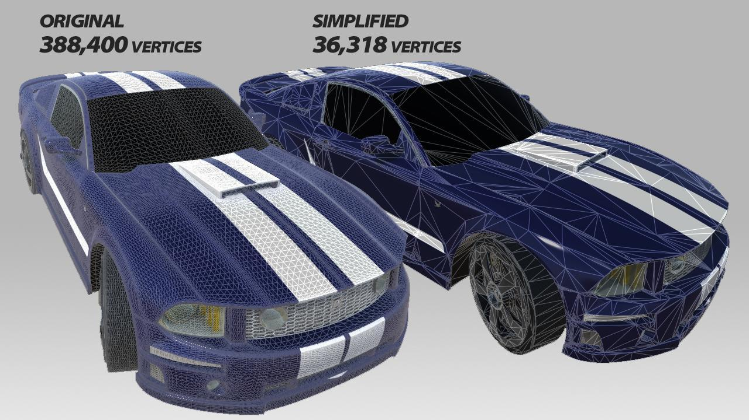
GPU Optimisation (4)
Level of Detail (LOD): All 3D games implement less detailed versions of models to display when a game element is far from the camera.
Unity has a built-in solution for constructing LOD’s
Vertex Optimisation: Instancing can be used for identical objects, models should be balanced between fidelity and optimisation.
Games will often swap out high-poly models in cutscenes and use lower-poly versions in normal gameplay. Asset Store | Mesh Optimizer
Notes:
There is a unity package but we will be making a basic solution to understand how the process would work.

Slide 14
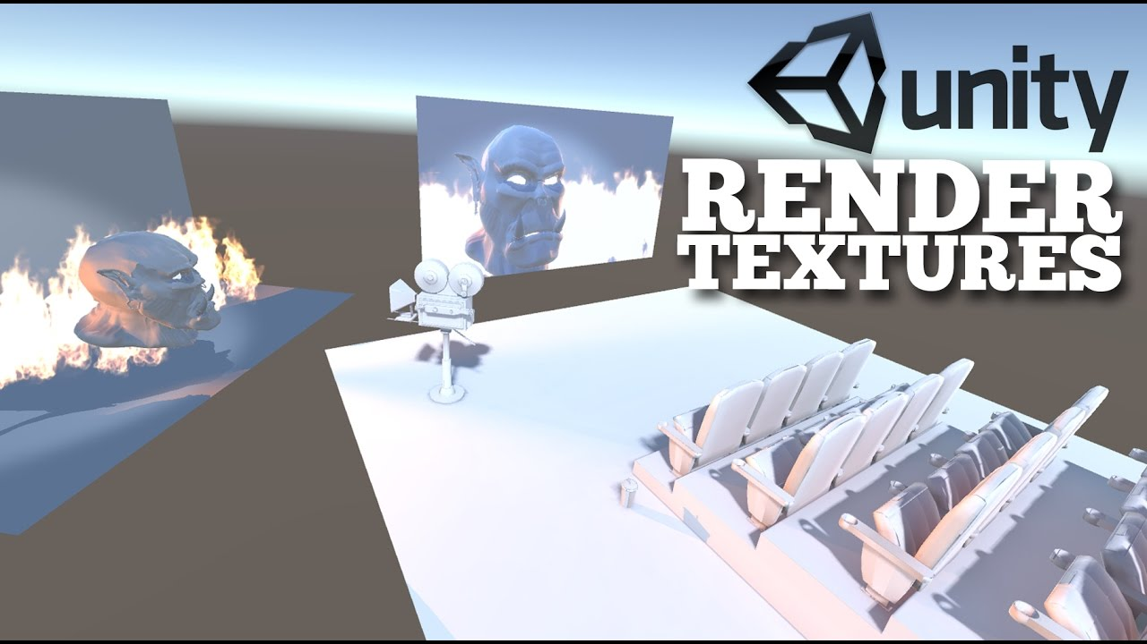
GPU Optimisation (5)
Multiple Cameras: Each additional camera requires a separate pass to render the scene, increasing CPU and GPU load.
Use layers effectively to limit what each camera renders.
Consider combining camera effects into fewer cameras where possible.
Skybox' and 'Solid Color' clear flags are generally faster than 'Don't Clear,' which requires Unity to redraw all pixels.
Notes:
There is a unity package but we will be making a basic solution to understand how the process would work.

Slide 15
03
Memory Management

Slide 16

Memory Management (1)
Running out of memory will result in a crash. There are two types of memory in C#
Stack: Grows & shrinks automatically. Objects get deleted when they are out of scope {}
Fast allocation
Smaller space
Heap: Data is managed manually. Objects created with the ‘new’ keyword are added to heap
Slower than stack
Larger and longer storage.

Slide 17
Memory Management (2)
Garbage Collection: A form of automatic memory management. The garbage collector frees up memory when objects are no longer accessible.
Performance Overhead: The GC requires CPU time to determine which objects are no longer in use.
Temporary Objects: Creating a lot of short-lived temporary objects, especially in frequently called methods like Update(), can trigger the GC to run more often.
Memory leaks: occurs when memory is not released once an object is no longer in use.
Static Variables: Remain for entirety of game session. Should not hold large data or objects
Events & Delegates: You must unsubscribe from any events you subscribe to. The reference will prevent that object from being deleted.
Notes:
There is a unity package but we will be making a basic solution to understand how the process would work.

Slide 18
04
ASync Operations

Slide 19
Async Operations (1)
Allows us to run tasks in the background without blocking the main thread.
Particularly useful when needing to load large amounts of data like a scene or large model.
Not a Fix-All Poorly optimized code will remain inefficient, even if run asynchronously.
Thread safety and race conditions need to be handled properly

Slide 20
05
Stress Testing

Slide 21

Stress Testing
A type of performance testing that intentionally places the game under extreme conditions to evaluate its stability, scalability, and overall performance. This could involve maxing out server requests, populating the game world with numerous entities, or intentionally throttling resources.
Reveal Weak Spots: uncovers areas where game might lag or break
Future Proof: Allows to prepare architecture for larger player base
Guidance: developers will know where to allocate their efforts for best return.

Slide 22
Stress Testing (2)
There are some key metrics that should be tracked to gauge performance
Frame Rate (FPS): Represents how many frames are rendered per second. A consistent and high FPS ensures smooth gameplay.
CPU Usage Percentage: Measures how much of the CPU's processing power is being used. Spikes in CPU usage can hint at inefficient code or intensive operations that might need optimization.
Memory Usage: Monitors the amount of RAM the game is using. Sudden increases might point to memory leaks or inefficient asset management.
Response Times: Measures the delay between an input (like a button press) and the game's response (like a character jumping). In multiplayer games, this might also refer to server response times.
Build Size: The total size of the game build. While not a performance metric per se, it can influence load times and storage considerations, especially on mobile devices or consoles with limited storage.
Notes:
There is a unity package but we will be making a basic solution to understand how the process would work.

Slide 23
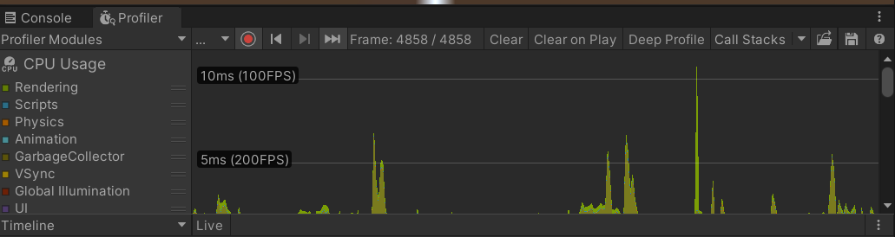
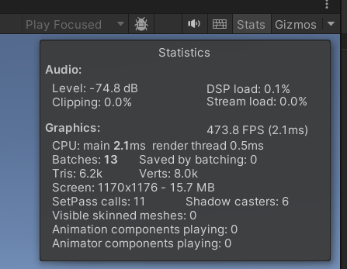
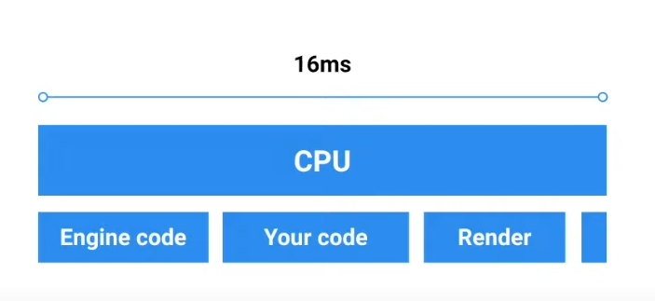
Stress Testing (2)
Unity Provides tools for profiling
Profiler: tracks the cpu usage and the frame rate allowing to spot problem areas in the code.
Stats: shows more streamlined information useful for looking at batching issues.
Notes:
There is a unity package but we will be making a basic solution to understand how the process would work.

Slide 24
Thanks!

